Slide 1
Digital Electronics
Lab *: Number System Conversions*

Slide 2


Welcome to Digital Electronics Class

Slide 3

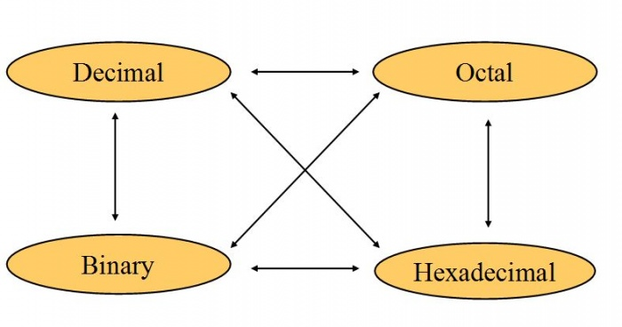
Number System Conversions
There are three types of conversion:
Decimal Number System to Other Base
Other Base to Decimal Number System
Other Base to Other Base

Slide 4
NS Conversions
Other Base System to Decimal
A) Determine the base value of source Number System (that you want to convert), and also determine the position of digits from LSB (first digit’s position – 0, second digit’s position – 1 and so on).
B) Multiply each digit with its corresponding multiplication of position value and Base of Source Number System’s Base.
C) Add the resulted value in step-B.

Slide 5
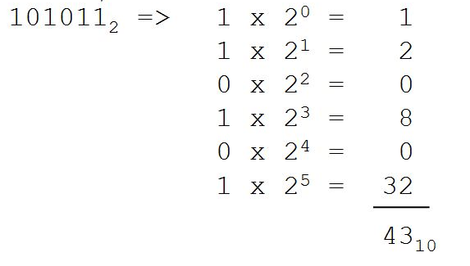
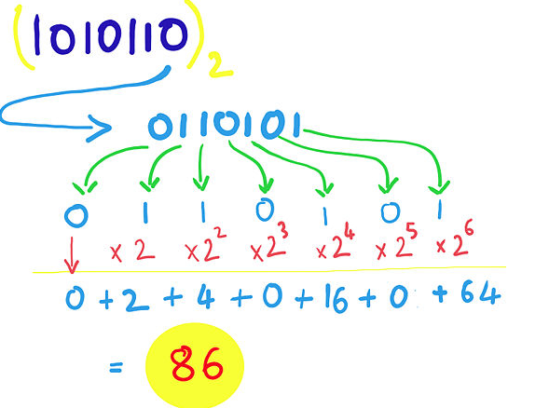
Binary to Decimal Conversion

Slide 6
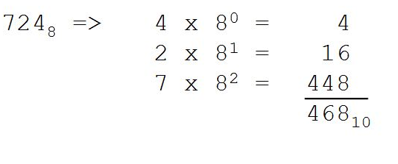
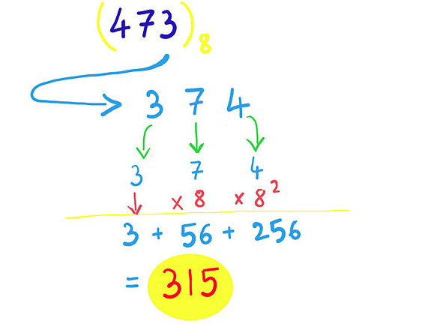
Octal to Decimal Conversion

Slide 7
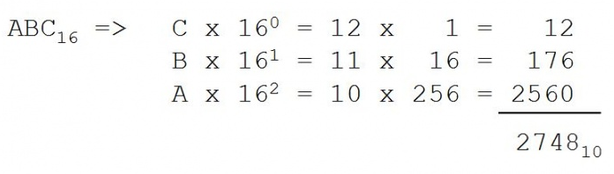
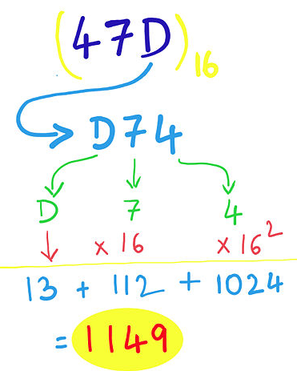
Hexadecimal to Decimal Conversion

Slide 8

Thank You!

